Slide 1
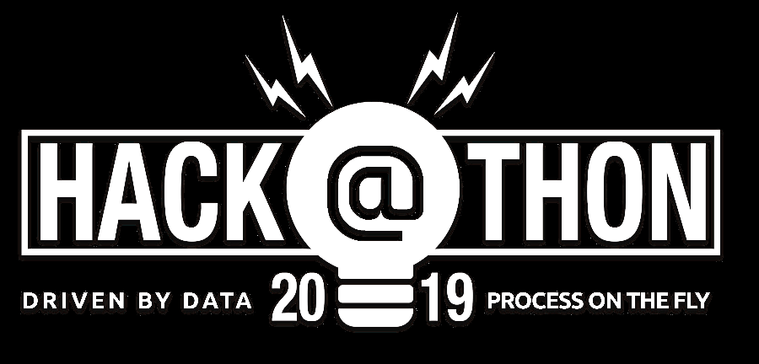
Hackathon 2019
Tech Fiesta 2019 Presents
Team NewGenTechies

Slide 2

Problem Statement
Wake up and Drive:
Car accidents are quite a menace and one such a reason is because of fatigue.
In 20 percent of all crashes and 16 percent of all near crashes, the driver was showing fatigue. Some of the reasons were eye-lid closure, head bobbing, severe loss of facial musculature, micro-sleep – which is when your eyes drift shut and then pop up. This was not just yawning. The drivers were asleep.
A solution need to be designed that must alert the driver if he/she shows signs of sleep because of fatigue.

Slide 3
Our Approach
Face Detection in Live Video stream using HOG
Finding Eyes among the Key Facial Landmarks (Co-ordinates)
Using Euclidean Distance Measure to find the Eyes Aspect Ratio to detect a blink
Calculating the number of active frames for which Eyes Aspect Ratio(EAR) is below threshold(0.25)
Alert the driver once number of active frames with EAR < 0.25 exceeds 30(Theoretical Threshold)
1
2
3
4
5
Notes:
Suppose if LH setup COE in Drupal it should be well known in applications development than we can make the COE as a success

Slide 4
Value Additions
Detect Yawning to prevent Micro Sleep
Finding Mouth among the Facial Landmarks and Calculate Mouth Aspect Ratio (MAR)
MAR falling below a threshold for certain Frames, detects Yawning
Detecting drowsiness using Mobile Camera Streaming
Sending alerts to selected contacts
6
7
8
9
10
Notes:
Suppose if LH setup COE in Drupal it should be well known in applications development than we can make the COE as a success

Slide 5


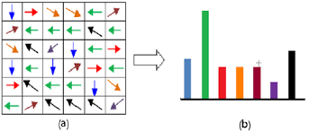




Technology Stack
Mobile Capturing
IP Webcam – Live feed from mobile devices
Programming
Python – Open source Programming Language
Detection
HOG – Best suited for Human Detection in Computer Vision
Computer vision Libraries
OpenCV – Real Time computer vision, Dlib - cross-platform software library
Packaging
Anaconda is a free and open-source distribution of the Python for package management and deployment
Operating System
Windows7 Professional

Slide 6
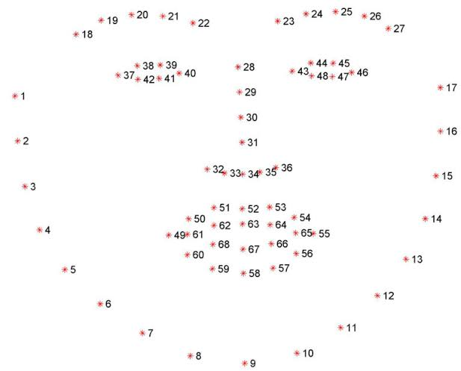
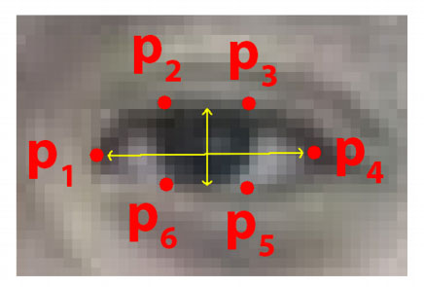
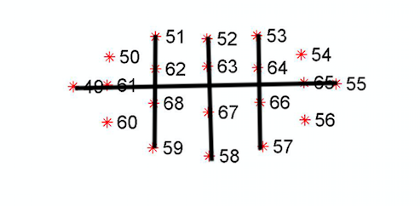
Execution Flow
Face acquisition using PC Camera
Face acquisition using Mobile Camera
Face Detected
Locate Eyes and Mouth as key facial Landmarks
EUCLIDEAN DISTANCE USING FACIAL LANDMARK
Calculating EAR and MAR
HOG is underlying algorithm to find Mouth among the Facial Landmarks
Calculating Mouth Aspect Ratio(MAR) based on Co-ordinates of landmarks using Euclidean Distance
Mouth Aspect Ratio(MAR) falling below a threshold for certain Frames, detects Yawning and alerts Driver prior to a Micro Sleep
Count frames for which EAR and MAR are below their thresholds
Voice alert warning the driver
NO
Number of frames (EAR and MAR) < Threshold value
YES
Send e-mail / text Alert

Slide 7
EYE CO-ORDINATES
EUCLIDEAN DISTANCE USING FACIAL LANDMARK
FACIAL LANDMARK
MOUTH CO-ORDINATES

Slide 8
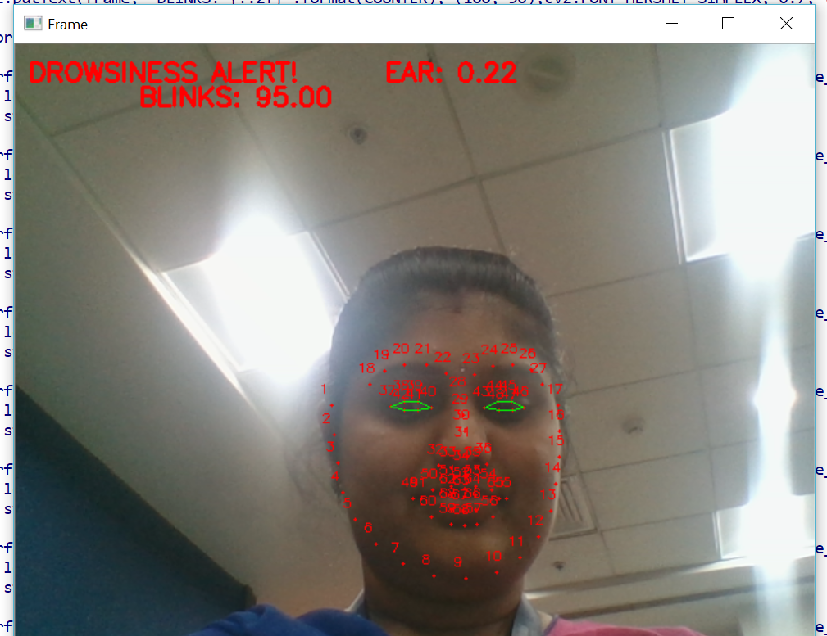
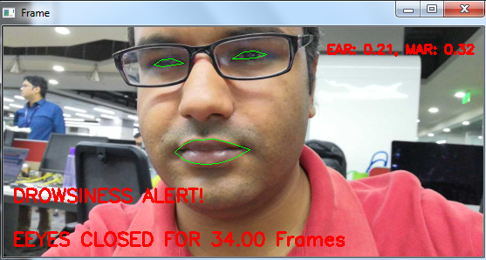
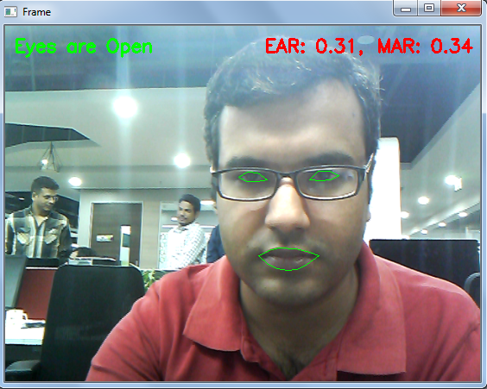
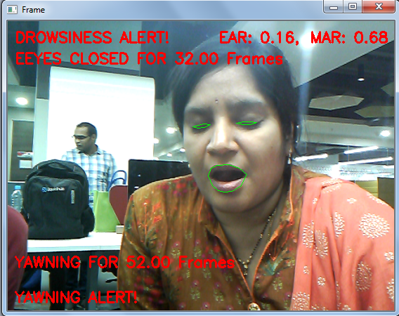
Feeds captured through Mobile and PC CAM

Slide 9
Challenges Faced
Face Detection and Finding ROI(Eyes, Mouth)
Capturing Frames via live Mobile Camera for Detection.
Depending on Frame rate the underlying mechanism to calculate Eye Aspect Ratio differs.
Development of Native Mobile App and Hardware requirements for more accuracy

Slide 10
Future Enhancement Ideas
Use of Heart Rate Variability(HRV) to detect Drowsiness
Native Mobile App for Ease of Use at no Cost
Detection of Cell Phone Usage While Driving
Collecting Data and use For Further analysis for more accuracy
Helping The Visually Impaired
Proliferation of Artificial Intelligence has increased by leaps and bounds. Face Recognition is no longer a fiction, in fact is being used by millions of people everyday via smartphone.

Slide 11
References
http://vision.fe.uni-lj.si/cvww2016/proceedings/papers/05.pdf
https://www.cv-foundation.org/openaccess/content_cvpr_2014/papers/Kazemi_One_Millisecond_Face_2014_CVPR_paper.pdf

